Slide 1
Isolation and Older Adults – Made Worse By COVID
Mark L. Meridy
Executive Director

Slide 2
DOROT’s Vision & Mission
Vision
DOROT will be an innovative leader in mobilizing volunteers of all ages to improve the lives and health of older adults, addressing the challenges of an aging society.
Mission
DOROT alleviates social isolation among older adults and provides services to help them live independently as valued members of the community. We serve the Jewish and wider community, bringing the generations together in a mutually beneficial partnership of elders, volunteers and professionals. Our work provides an effective model for others.

Slide 3
DOROT By The Numbers
Founded 45 years ago in 1976
Engaged over 5,507 Older Adults
Participated in over 84,410 programs
Average age of a DOROT client is 82 with 64% of them living alone.
Engaged over 6,000 Volunteers
Pre-COVID primary focus was NYC and Westchester County
Now a virtual platform and engage older adults from 20 states and volunteers from 39 states.

Slide 4
Challenges of an Aging Society
Every day in the US, 10,000 people turn 65; will represent over 20% of the population by 2050.
More older adults are living alone and farther from family supports
43% of adults 60+ report feeling lonely
Retirement at 65 or 70 - often live for 20+ more years
Lack of a sense of purpose and usefulness
Of those 65+, the 85+ is the fastest growing cohort - increasingly need services at home or in the community to maintain their independence.
All contribute to increasing risk
of social isolation

Slide 5
COVID and Older Adults Deadly Consequences
Majority of COVID cases were in those under the age of 50
However, 80% of the deaths from COVID were those 65+
For many older adults COVID resulted in increased loneliness and social isolation
Decline in overall health
Mental acuity impacted by not engaging with the outside world
Increase levels of depression

Slide 6
We Know that meaningful
social engagement is critical.
DOROT provides a range programs to improve the quality of life, independence, and social connectedness of older adults

Slide 7
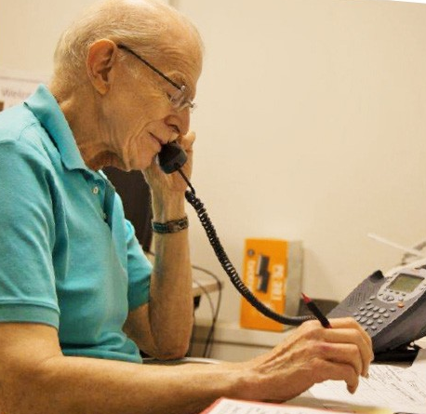
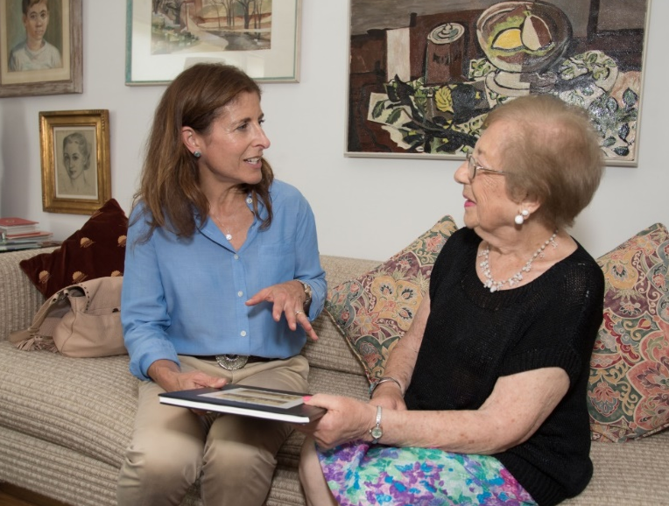
Building Social Connections Through Vibrant Programming with Peers and Volunteers
Support over 500 Friendly Visiting Matches – Now Virtually
Onsite Programming became Onsite@Home – COVID Response
Caring Calls – (700 telephone matches) COVID Response
University Without Walls – Expanded during COVID

Slide 8
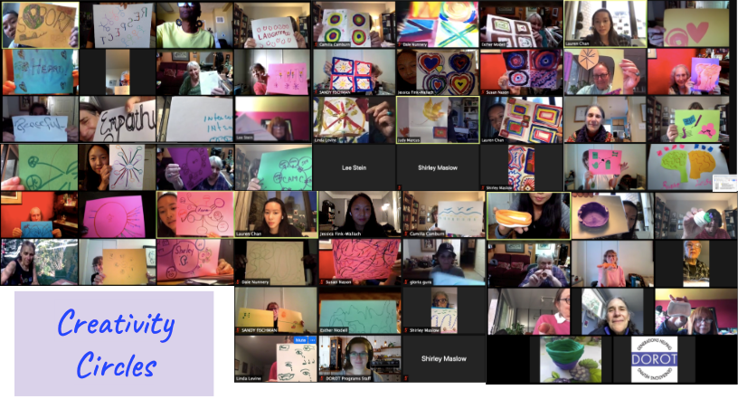
Successful Partnership with
The UnLonely Project
Aging Creativity Circles & DOROT
Back to Basics
Emphasizes Shared Experiences
Builds Community
Noteworthy Positive Results!
Tool for connection across community organizations
Educational tool
Notes:
Successful Aging Creativity Circles + DOROT - Bold is for slide, nonbold is for narrative (not included on slide)
Back to Basics: The curriculum is simple and includes straightforward activities that provide simple satisfaction and quick pay-off. The activities made it easy to engage in arts and discussion. Friendly for all comfort levels.
Emphasizes Shared Experiences: Curriculum gives older adults insight into how similar to shared struggles, gives common ground and opportunity to see how other people deal with similar situations in different ways
Builds Community: Appreciate, enjoy progression of community we built over 8 weeks. Noticeable different between participation at beginning, participation now. An ease to which participants show up and respond to the prompts and each other.
Noteworthy Positive Results! Results from the Foundation for Arts & Healing showed confidence around managing aging, better able to modulate emotions, improved quality of life, increase sense of meaning in life, greater resilience
Additional points, if want to include:
Tool for connection across community organizations: Online platform; easy to navigate. Resources have been available to us, actively work to make sure we can connect with other facilitators in online forum and zoom calls.
Educational tool: Benefits for student facilitators to have this experience. New to facilitating, our group leaders felt more prepared to manage time in a group setting. Participants are comfortable sharing in between sessions, openness between participants and facilitator

Slide 9



Appreciating the Impact of Human Connection

Slide 10
Thank You
www.dorotusa.org

